Slide 1
HUMAN DIGITAL TWIN ARCHITECTURE FOR GROUND VEHICLE
SCENARIO INTEGRATION
Martin McCarthy, Abdul Mannan Mohammed, Reese Gallagher, Carsten
Neumann, Gerd Bruder, Dirk Reiners,
Carolina Cruz-Neira, and Victor Paul
DISTRIBUTION STATEMENT A.
NOT Approved for public release; distribution is unlimited. OPSEC # 10948

Slide 2
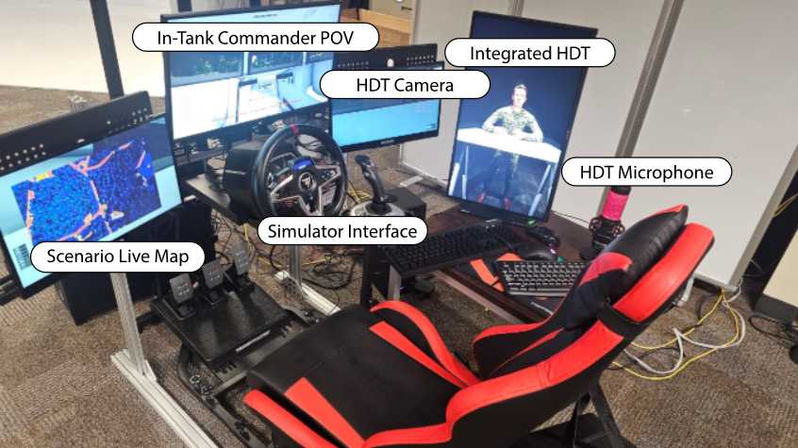
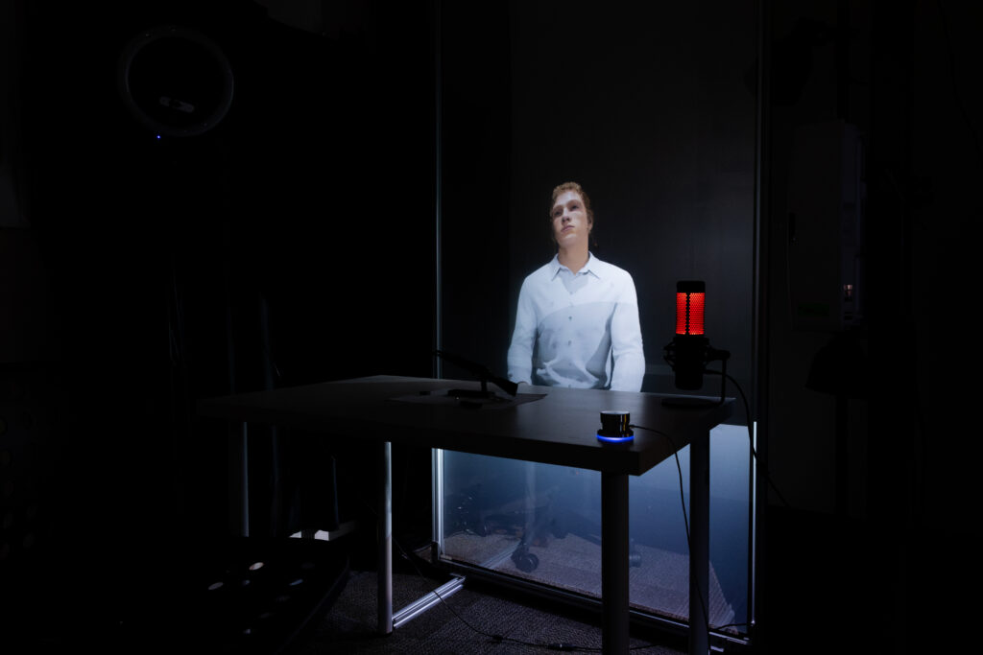
Introduction
Ground vehicle commanders face high levels of cognitive load.
Tracking sensors, crew status, mission context, and digital displays in real-time divides attention, causing critical cues to be missed.
Human Digital Twin (HDT) architecture is an embodied AI crew member that monitors mission context, user focus, and environmental state in real-time.

Slide 3
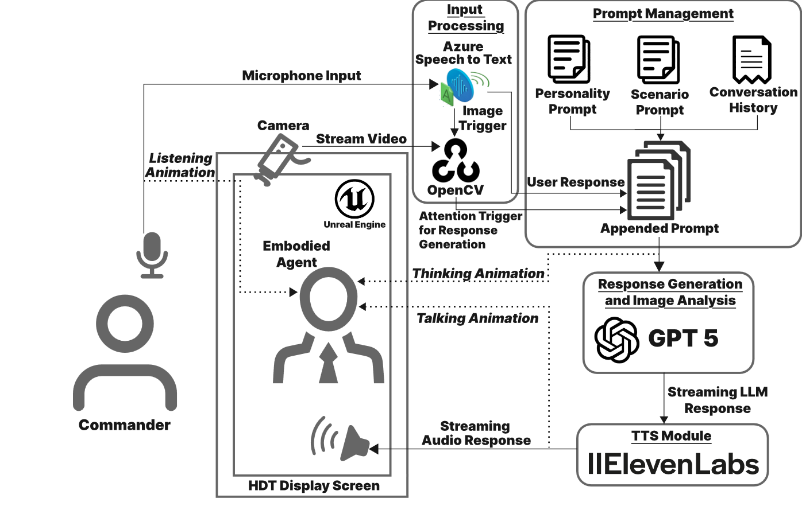
Architecture
MetaHuman avatar in Unreal Engine 5.6
Utilizes multi-modal data ingestion
Processes user speech input
Provides a vision-based focus detection
RAG-based mission context
LLM Response Generation
Streaming TTS Output

Slide 4
Architecture – Camera Input
Collects information from camera for facial expression of the user.
  FER (Facial Expression Recognition) library -> Deep learning CNN trained on the FER-2013 dataset.
  Classifies faces into 7 emotional categories: Happy, Sad, Angry, Fear, Surprise, Disgust, and Neutral
  This gives HDT a baseline method for determining how to engage its conversations with the user.

Slide 5
Architecture – Camera Input
  In addition, can track the position of the face utilizing MediaPipe to know what screen the user is looking at.
  This allows HDT to know if a commander is missing a potential mission objective while monitoring a different one.

Slide 6
Architecture – Data Input
  Baseline mission information is fed into a local RAG model system for retrieval of important tasks that the HDT should be aware of in real-time.
  Information files are chunked and tokenized.
  Query takes last user message and tokenizes it, then scores it against the tokenized database to find what is relevant to the current mission objectives.
  This feeds into the LLM with the camera input to provide the current relevant context.

Slide 7
Architecture – User Input
  The commander can at any time trigger an interaction with the HDT, we’ve deployed a variety of methods for this throughout different integrations.
    Wake word activation, button pressing, open microphone.
    Python module that feeds information to Unreal Engine
    PyAudio opens the microphone reading 100ms chunks, sent to gpt-4o-mini-transcribe which returns the transcribed output of the user
    When end of turn is detected, this sends to GPT 5 with streaming enabled to get quick responses from the system.
  LLM Response feeds to ElevanLabs model Flash v2.5, which is their low-latency streaming model

Slide 8
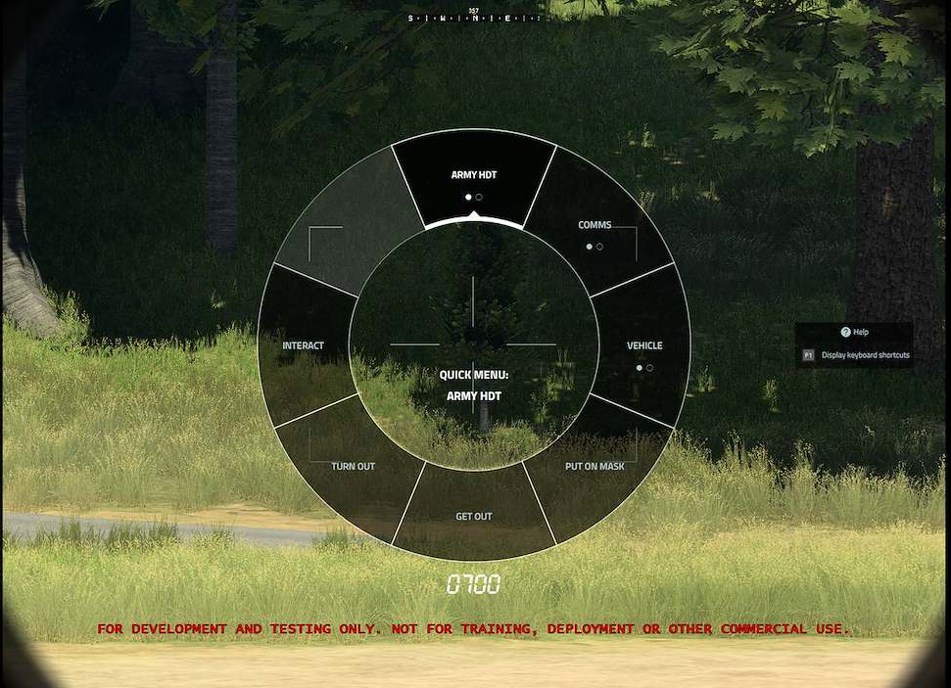
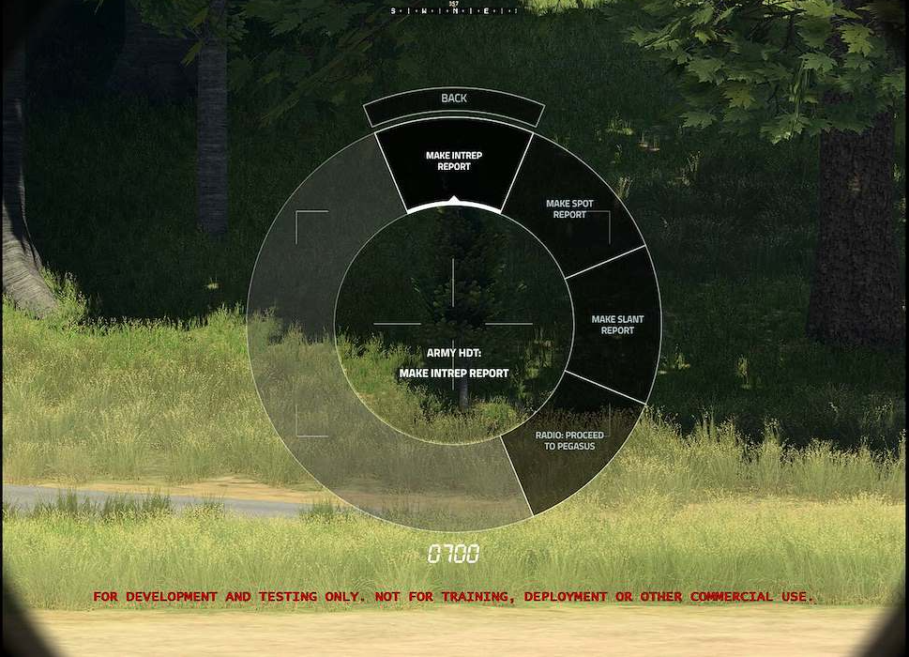
Mission Scenario
  HDT is tested in a POW camp scouting mission
  Commander operates from a tank, directs multiple vehicles, sends reports, monitors resources, and maintains awareness of event missions.
  Scenario built in VBS

Slide 9
Mission Scenario
  Commander is tasked to know:
    When a vehicle diverts from the course
    Armed individuals appear near a target area
    Prisoners are offloaded into a building
    Enemy forces begin engaging the team

Slide 10
Mission Scenario
  HDT supports decision-making during the process but does not make decisions itself.
  During enemy engagement, it can alert the commander, but commander makes decision to retreat themselves.

Slide 11
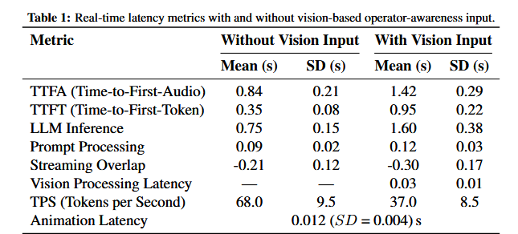
System Evaluation
  HDT is real-time performant, average time to first audio is 0.84 seconds without vision input, 1.42 seconds with vision input.

Slide 12
Conclusion
  Work shows that HDT can act as context-aware AI teammate
  By combining data ingestion, attention awareness, RAG, and embodied AI, the system can help commanders notice and interpret critical events.
  Future integration will interface the HDT architecture with ProjectGL and WMI.
  Detection of cognitive load will be established to feed the HDT a better understanding of the commander’s state to help assist better.

